Slide 1
THE EXAM SCHEDULING PROBLEM
Solve exam scheduling problem using a genetic algorithm, hillclimbing, random search, and a variant of simulated annealing (mutate search)
Compare how each algorithm performs in small/medium/large data sets.
Development tools: java and mathematica

Slide 2

FITNESS FUNCTION
We need a fitness function to determine how good a schedule is.
the fitness of a schedule means how much each student or room likes their given timetable.
For both a student and a room, the fitness function is
Runtime: a single evaluation of the fitness function took 0.2 seconds for a large data set.

Slide 3
GENETIC ALGORITHM
It maintains a population of schedules and constructs subsequent generations
To generate a new schedule: random, copying, mutation, crossover
Mutation/crossover: schedules are selected with a probability proportional to their fitness.
free parameters: size of the population, number of generations, proportions of copy, random, mutation, and crossover

Slide 4
OTHER SEARCH ALGORITHMS
Random Search: randomly generate some schedules, return the one with highest fitness.
mutate-search: Make 1% changes to the current best one and check the fitness. If the new one is better, replace the old one.
Hill Climbing: examines every schedule in the neighborhood of a given schedule, then continues from the best one, until it reaches the maximum number of evaluation allowed.

Slide 5
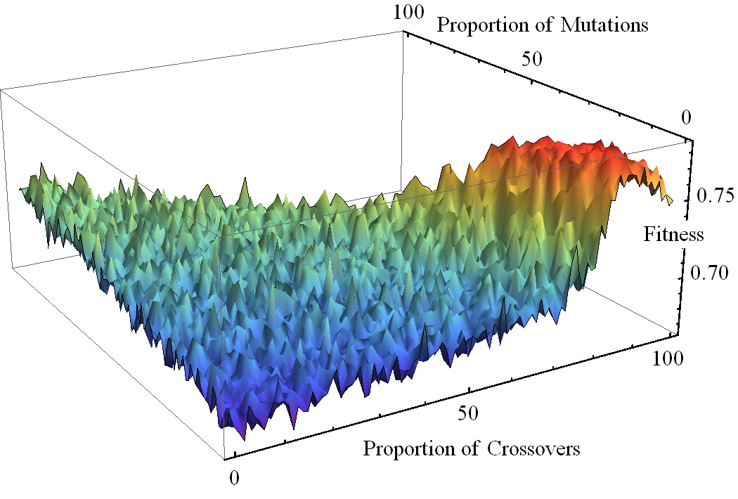
GENERATION PARAMETERS FOR GA
Crossover is outperforming!

Slide 6
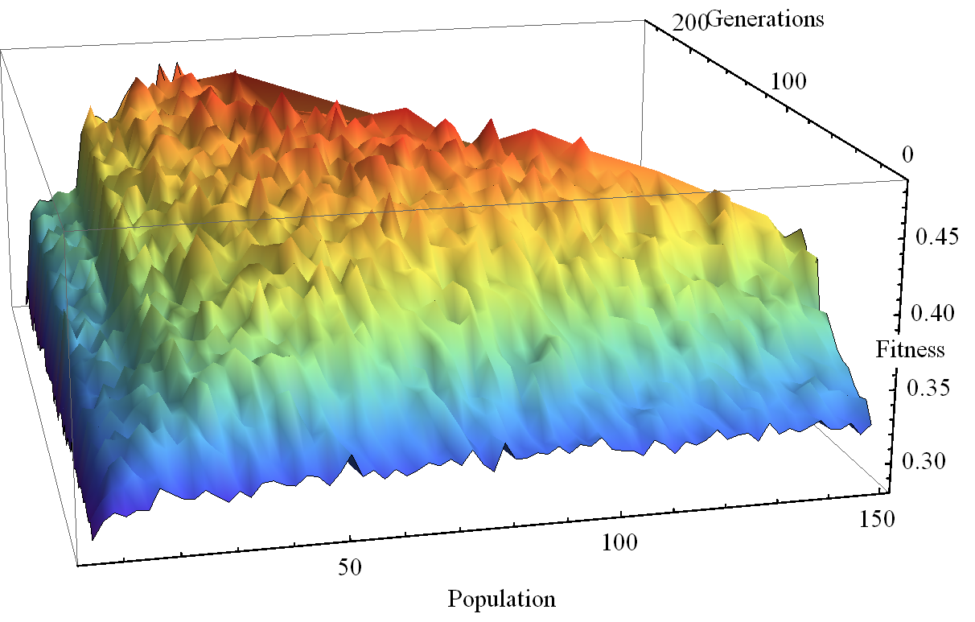
SIZE PARAMETERS FOR GA
the population per generation and the number of generation seem to both influence as much the fitness.

Slide 7
HOW TO TEST THE ALGORITHMS?
We would like to compare data sets which their courses are with and without correlation.
We want to see how these algorithms perform with small/medium/large data sets.
Thus we have 2 sets of 3 differently sized scheduling problem instances to test our algorithms.
The large data set is actual U of T data.

Slide 8
TESTING DATA
 | Small | Medium | Large | Small w/ Correlations | Medium w/ Correlations | Large w/ Correlations
Days | 7 | 10 | 7 | 7 | 10 | 7
Time slots | 5 | 8 | 8 | 5 | 8 | 8
Courses | 20 | 200 | 603 | 20 | 200 | 600
Rooms | 4 | 10 | 43 | 4 | 10 | 43
Students | 50 | 300 | 21945 | 50 | 300 | 21945
Courses taking | 1-5 | 1-6 | 1-5 | 2-6 | 2-6 | 2-6
Number of Majors | N/A | N/A | N/A | 4 | 10 | 20
Search space size | 10¹⁸² | 10¹⁸⁴⁰ | 10⁶⁶⁹⁵ | 10¹⁸² | 10¹⁸⁴⁰ | 10⁶⁶⁸⁹

Slide 9
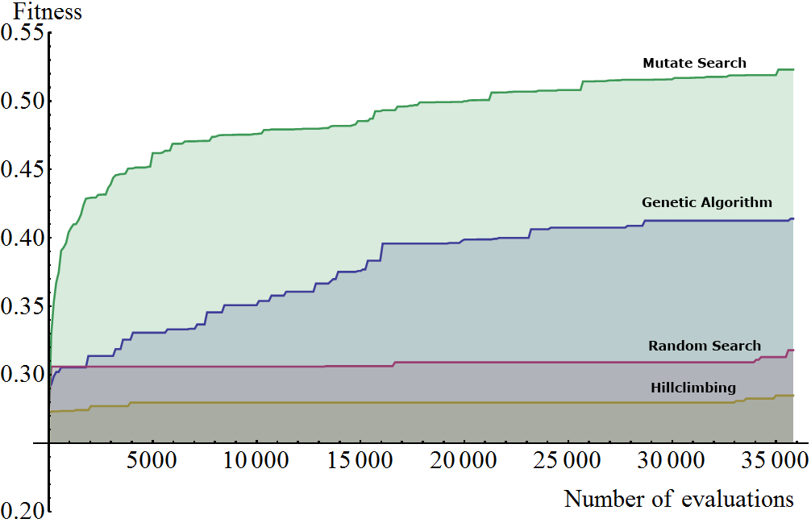
COMPARING ALGORITHMS (LARGE DATA)

Slide 10
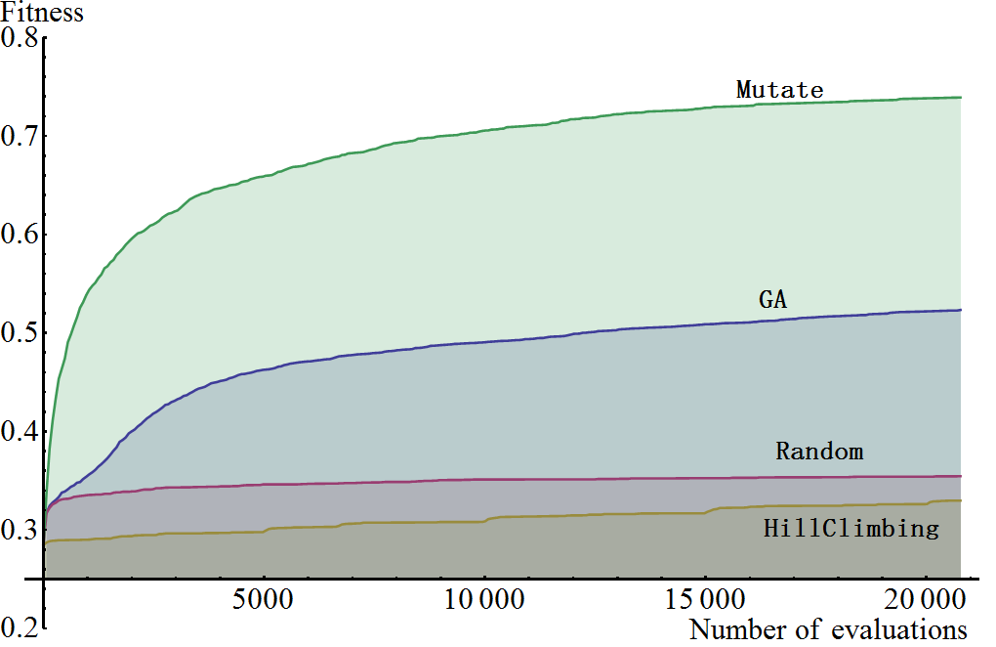

COMPARING SIZES (MEDIUM VS LARGE)
Large with correlation:
Medium with correlation:

Slide 11
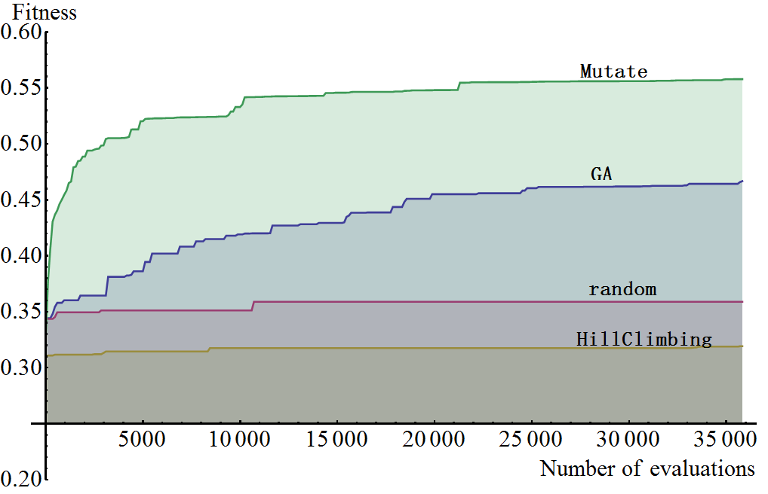
WITH VS WITHOUT CORRELATION (LARGE)
without correlation:
with correlation:

Slide 12
CONCLUSIONS
Hillclimbing is not so valuable for this problem, if the data gets big, it will get stuck at a low local maxima.
GA solves the problem pretty decently, but simulated annealing (mutate search) performs better.
Searches perform better on data without course correlations than on those with correlations.

